Slide 1


Capstone Project
MALAIKA TARIQ

Slide 2
Introduction
I was assigned to perform a sales analysis for EmporiUm, a student bookstore chain that also sells tech products, art supplies, and other products in the state of South Carolina (In-Store).
Len Jensen, manager for South Carolina assigned me to analyze:
Sales data for two in-store locations;
- Greenville (Store 853)
- Charleston (Store 852)
Date period: January 1, 2022 - December 30,2025 (4 years)
Answer key questions about the territory’s sales performance.

Slide 3
Sales Analysis
What is total revenue overall for sales in the assigned territory, plus the start date and end date that tell you what period the data covers?
What is the month by month revenue breakdown for the sales territory?
Provide a comparison of total revenue for the specific sales territory and the region it belongs to.
What is the number of transactions per month and average transaction size by product category for the sales territory?
Can you provide a ranking of in-store sales performance by each store in the sales territory, or a ranking of online sales performance by state within an online sales territory?
What is your recommendation for where to focus sales attention in the next quarter?

Slide 4
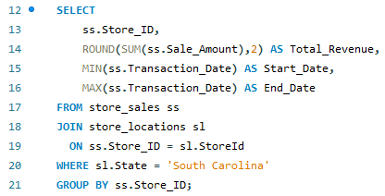

1. What is total revenue overall for sales in the South Carolina territory, plus the start date and end date that tell you what period the data covers?
Result
Query

Slide 5
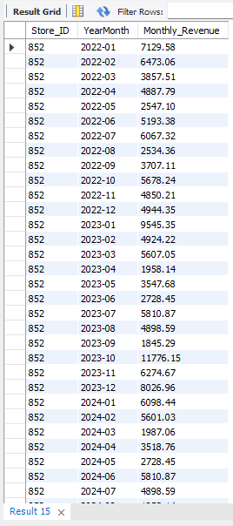
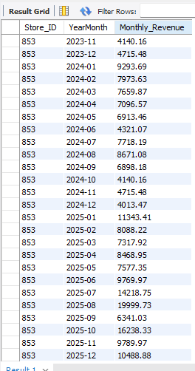
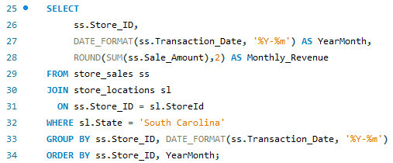
2. What is the month-by-month revenue breakdown for the sales territory?
Result
Query

Slide 6
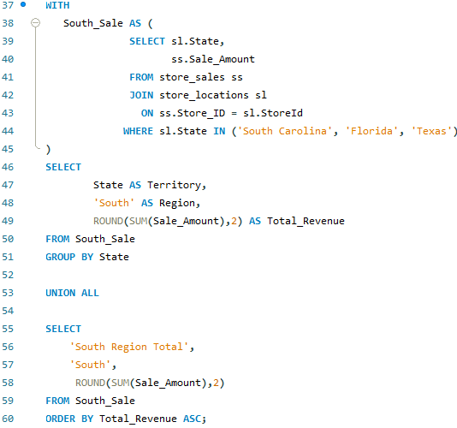
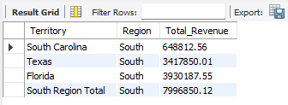
3. Provide a comparison of total revenue for the South Carolina sales territory and the region it belongs to.
Result
Query

Slide 7
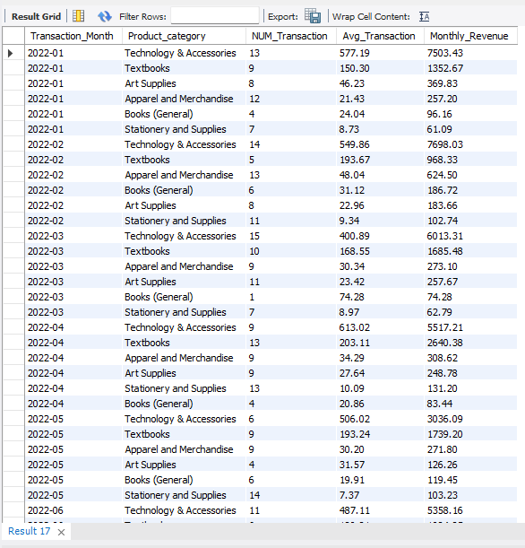
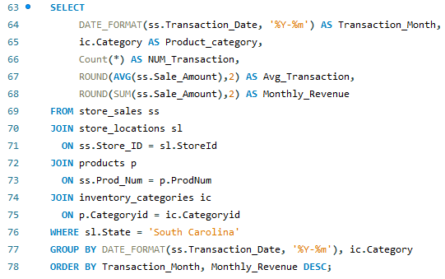
4. What is the number of transactions per month and average transaction size by product category for the sales territory?
Result
Query

Slide 8
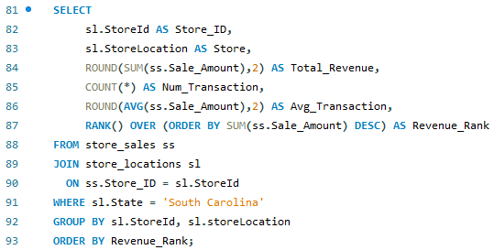

5. Can you provide a ranking of in-store sales performance by each store in the sales territory, or a ranking of online sales performance by state within an online sales territory?
Result
Query

Slide 9
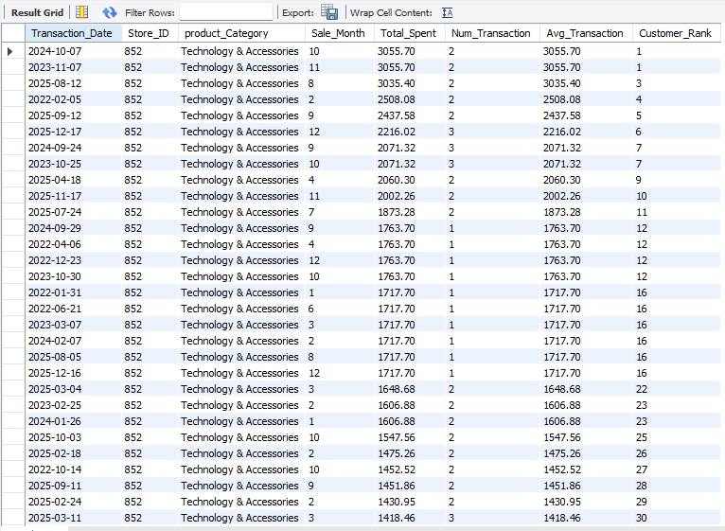
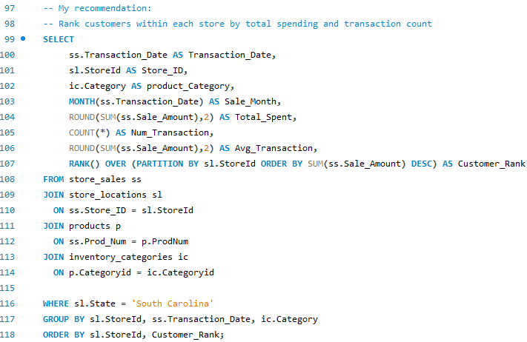
6. What is your recommendation for where to focus sales attention in the next quarter?
Result
Query

Slide 10
How I Reached This Recommendation
Finding from Analysis | What It Told Me
Q1: Charleston store 852 generates $311,810.56 over the last 4 years | Charleston store 852 is a strong, consistent revenue contributor
Q2: Revenue up 119% since 2022 | Both stores are growing year over year with 2025 showing the strongest performance overall
Q3: South Carolina is 8.1% of South Region. It has only 2 stores as compared to Florida and Texas | There is room to grow market within the region
Q4: Tech with revenue of $472,118.34 and average of $483.23 | Tech & Accessories is the dominant revenue driver — prioritize it
Q5: Greenville ranks #1 store overall | Average transaction size is almost same in both stores
Q6: Top customer spent $3,055.70 | Highest-value customers are concentrated in Tech
Q6: Avg transaction up to $3,055.70 | Average transaction value is high in tech and accessories
Q6: All top-ranked results: Tech & Accessories | No competing category — 100% dominance in top rankings
Q6: Store 852 in South Carolina | Focus inventory, promotions, and staff training at this store

Slide 11
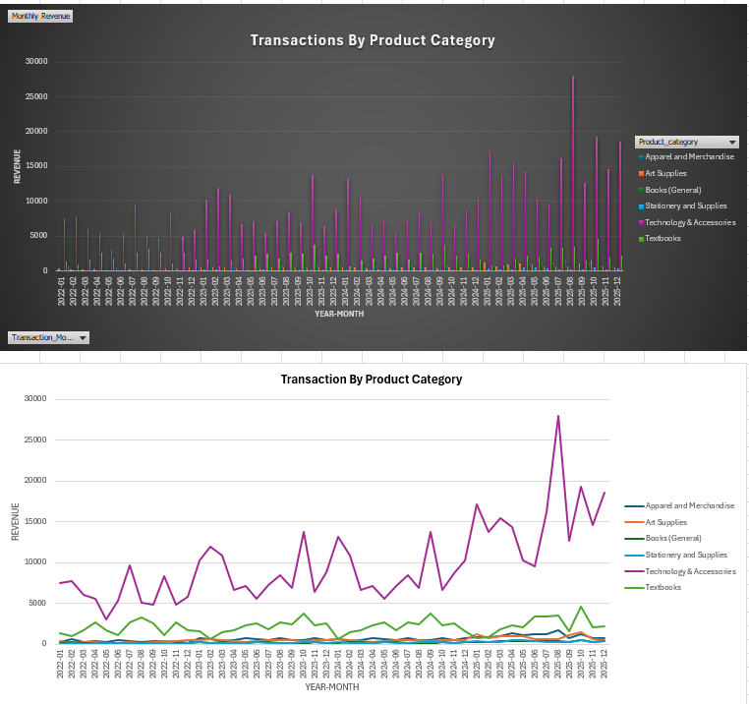
Visualization
Question
PivotChart
QUESTION# 4:
What is the number of
transactions per month
and
average transaction size
by product category
for the sales territory?

Slide 12
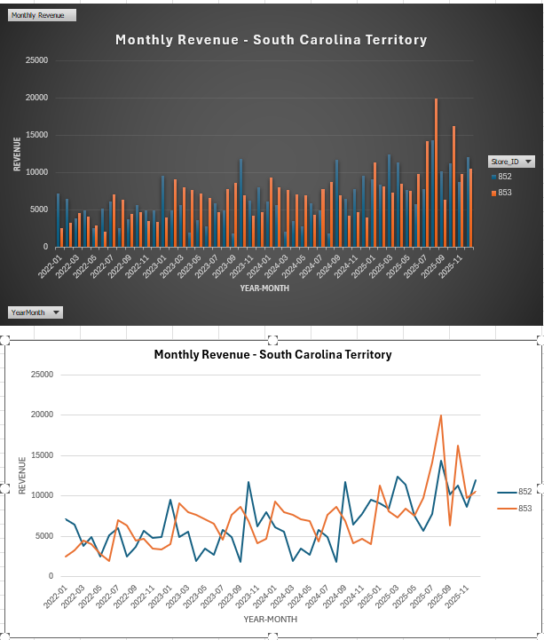
Visualization
Question
PivotChart
QUESTION# 2:
What is the
month-by-month
revenue breakdown
for the sales
territory?

Slide 13
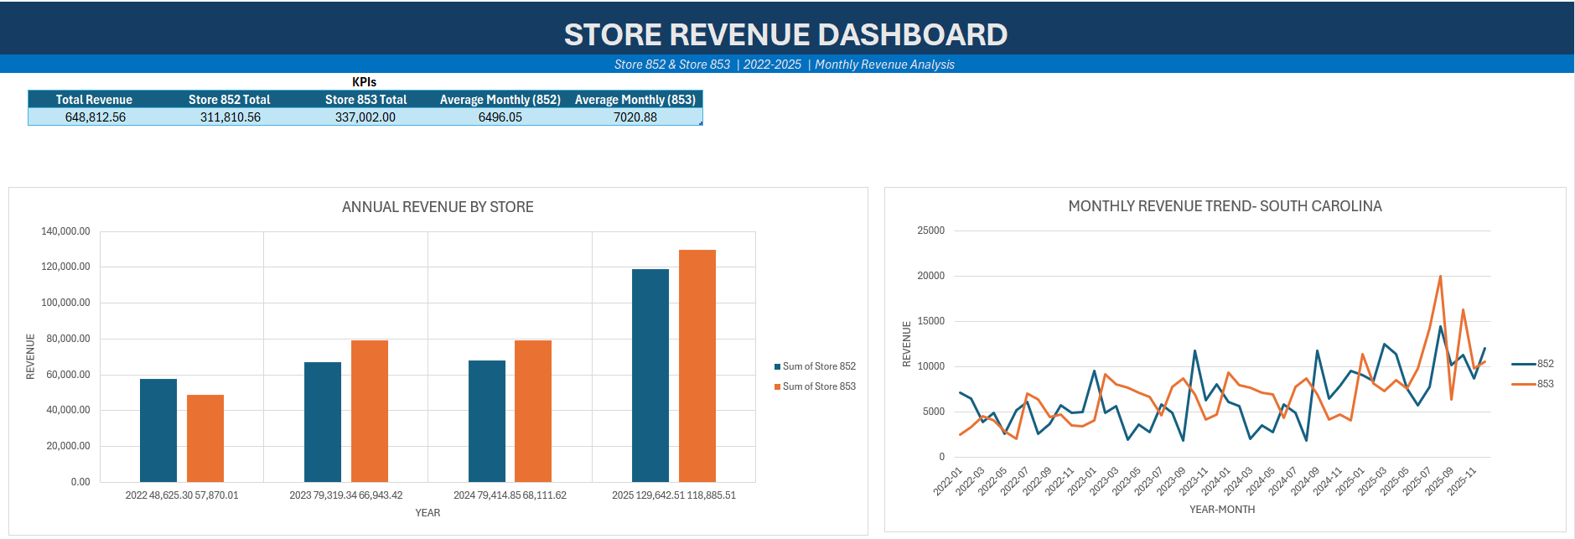
DASHBOARD- Store Monthly Revenue

Slide 14
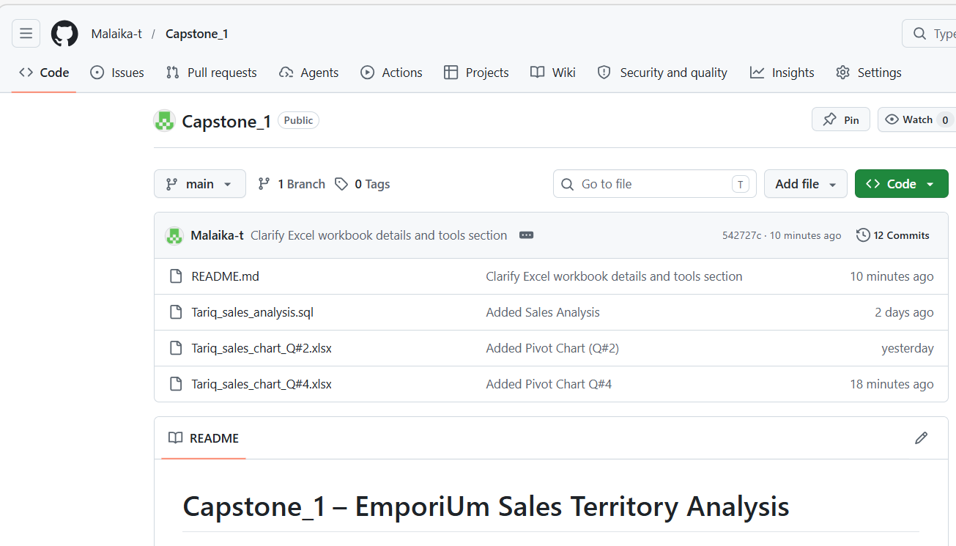
GitHub Repository

